Slide 1
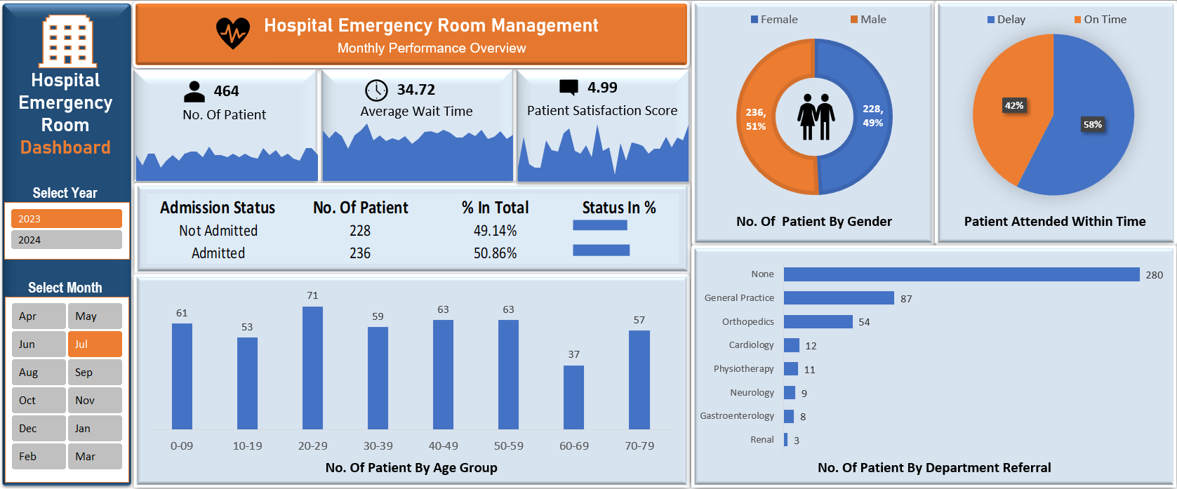
Hospital Emergency Room Management Dashboard
Interactive Data Analytics Project Using Microsoft Excel
Prepared by Anup Sharma

Slide 2
Project Overview
Interactive Excel dashboard built from two years of emergency-room patient data.
Year and month selections dynamically update KPIs and visual analyses.
Combines executive summary reporting with detailed daily drill-down trend pages.

Slide 3
Problem Statement
Raw emergency-room records are difficult to interpret quickly.
Management needs visibility into patient volume, waiting time, satisfaction, admissions, timeliness, demographics and referrals.
The solution centralizes these metrics in an interactive analytical dashboard.

Slide 4
Project Objectives
Track patient volume, average wait time and satisfaction score.
Analyze gender, age groups, admission status and department referrals.
Compare on-time attendance with delays.
Enable year/month filtering and daily drill-down analysis.

Slide 5
Project Steps
📋 Business Requirement
📂 Understand Dataset
Import Data (Power Query)
Clean & Validate Data
📅 Calendar Table
🔄 Data Modeling
➕ DAX Measures
📊 Pivot Tables
📈 Charts
📑 Dashboard
💡 Business Insights

Slide 6
Dashboard Analysis Modules
KPIs: Total Patients, Average Wait Time, Patient Satisfaction Score
Demographics: Gender and Age Group distribution
Operations: On Time vs Delay and Admission Status
Referral Analysis: Patient counts by department
Dynamic interaction: Year and Month selection

Slide 7
Main Interactive Dashboard

Slide 8
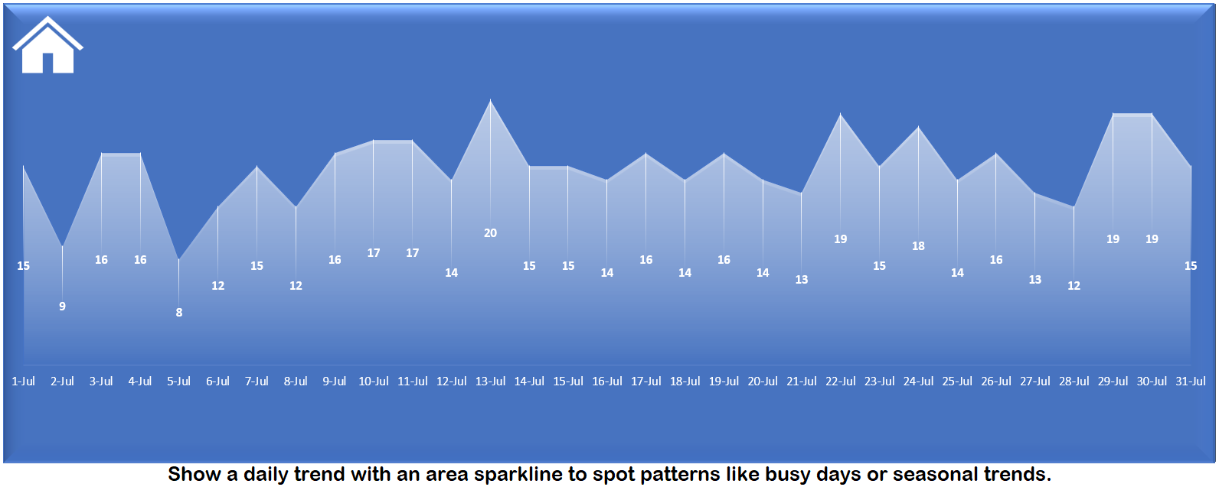
Daily Patient Visit Trend

Slide 9
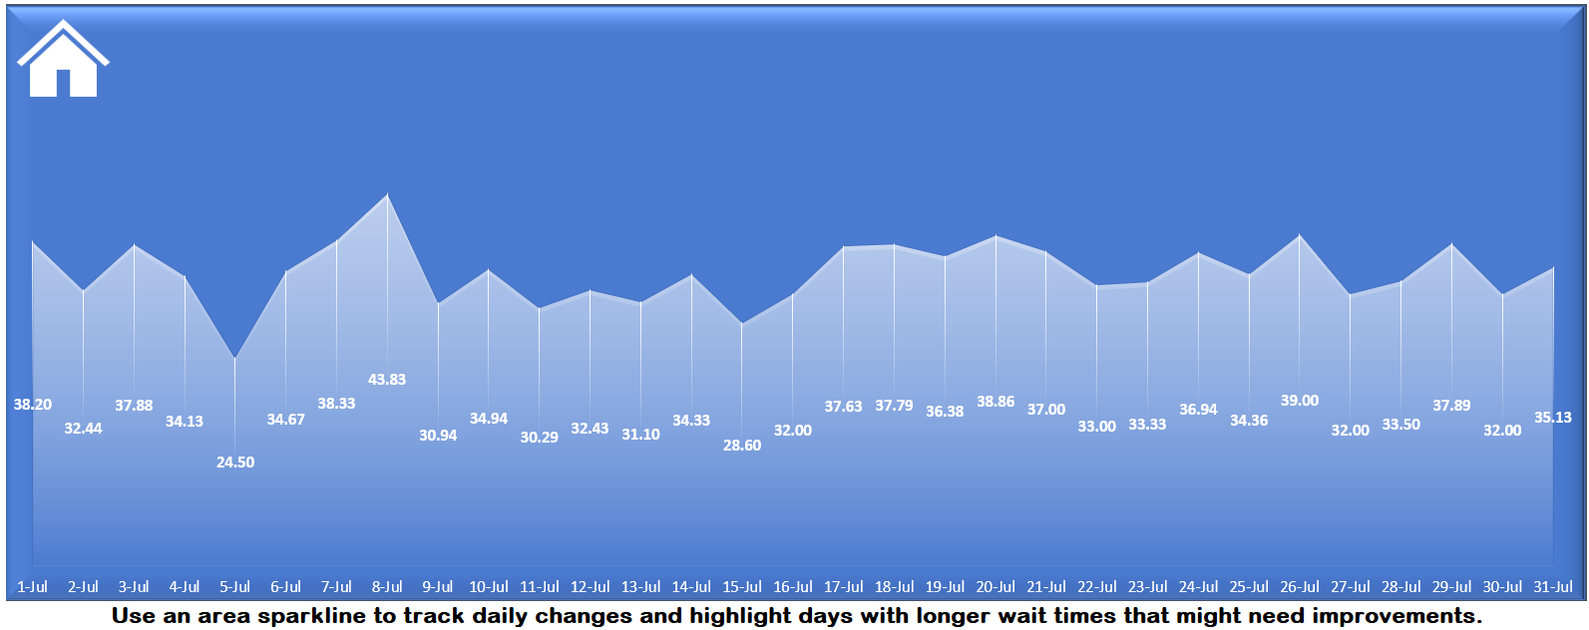
Daily Average Wait Time Trend

Slide 10
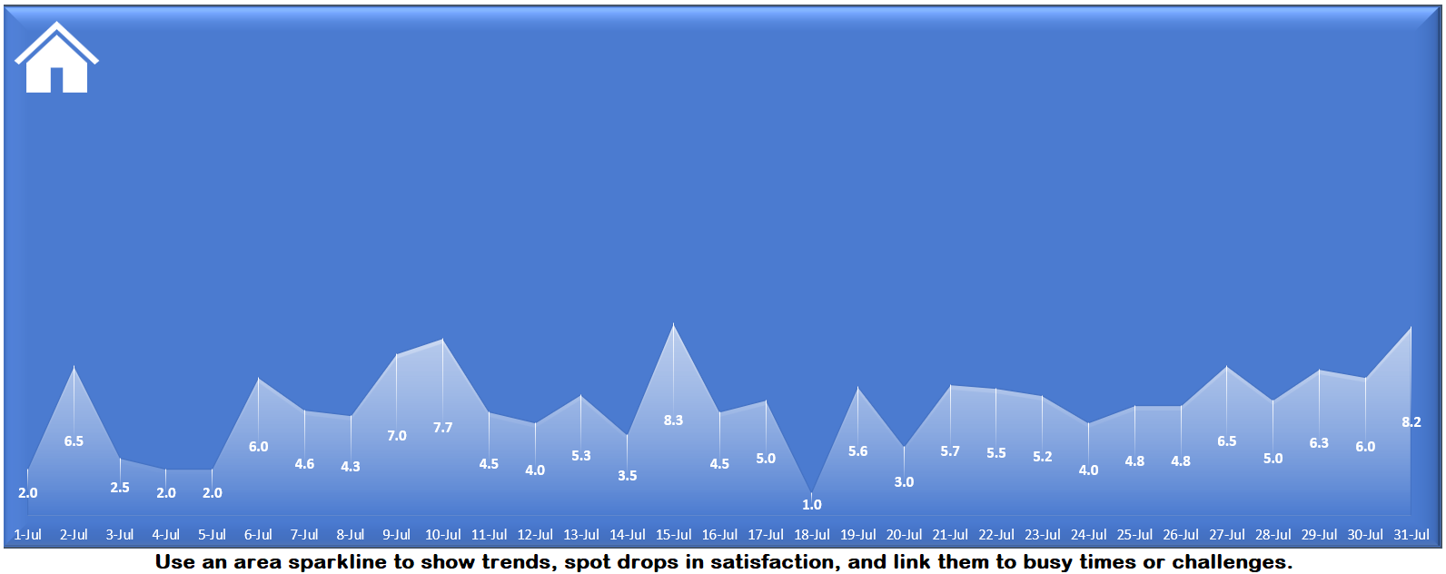
Daily Satisfaction Score Trend

Slide 11
Charts to Create:
Patient Admission Status: Show how many patients were admitted vs. not admitted.
Patient Age Distribution: Group patients by age.
Timeliness: Measure the percentage of patients seen within 30 minutes.
Gender Analysis: Display the number of patients by gender.
Department Referrals: Check which departments patients are referred to the most.

Slide 12
Interactivity & Navigation
Selecting a year and month changes all dashboard metrics and charts.
KPI-linked detailed pages provide daily trend analysis.
Home buttons allow quick navigation back to the main dashboard.
The design supports both summary monitoring and detailed exploration.

Slide 13
Calendar Table Formula
= List.Dates(#date(2023,01,01),731,#duration(1,0,0,0))

Slide 14
DAX Formulas
DAX Formula for Age Group :
=IF([Patient Age]>=70,"70-79",IF([Patient Age]>=60,"60-69",IF([Patient Age]>=45,"45-59",IF([Patient Age]>=30,"30-44",IF([Patient Age]>=15,"15-29",IF([Patient Age]>=5,"05-14","0-4"))))))
DAX Formula For Patient Attend Status :
=IF([Patient Waittime]<30,"Within Time","Delay")

